Slide 1






ADO . NET

Slide 2

Overview
Command Object
ExecuteScalar
DataReader Object
The DataSet Object
DataSets vs. DataReaders
Data Adapter Object
The Mapping Mechanism
DATA TABLE
Namespaces
Design Goals for ADO.NET
Introduction
What is ADO?
Evolution of ADO.NET
What Is ADO.NET?
Where does ADO.NET sit?
Comparison of ADO and ADO.NET
ADO.NET Architecture
ADO.NET Data Providers
Connection Object

Slide 3


Introduction
ADO.NET is the new database technology of the .NET platform.
It builds on Microsoft ActiveX� Data Objects (ADO).
ADO.NET is a set of libraries included in the .NET framework to facilitate the communication of applications with various data storage mechanisms.
ADO.NET is an expansion of ADO .
ADO.NET allows you to use data commands to execute SQL Statements or Stored procedures from a client application.
The Classes of ADO.NET are defined in the System.Data Namespace.

Slide 4


What is ADO?
Microsoft's ActiveX Data Objects (ADO) is a set of Component Object Model (COM) objects for accessing data sources.
ADO was introduced by Microsoft in October 1996.
ADO is automatically installed with Microsoft IIS.
ADO is an application programmer's interface (API) that provides developers with an easy way to access the underlying OLE DB data access interface.

Slide 5
Where does ADO.NET sit?
VB
C#
C++
Jscript
…
Common Language Specification
ASP.Net
Windows Forms
ADO.Net
XML.Net
Visual Studio .NET
Base Class Library
Common Language Runtime (CLR)
Windows
COM+ Services

Slide 6

Comparison of ADO and ADO.NET
In-memory Representations of Data
  In ADO, the in-memory representation of data is the recordset.
  In ADO.NET, it is the dataset.
Sharing Data Between Applications
  Transmitting an ADO.NET dataset between applications is much easier than transmitting an ADO disconnected recordset.

Slide 7


Comparison of ADO and ADO.NET
Data Storage:
  ADO recordsets gather one or more tables into a single recordset object, which then mimics a single table.
  ADO.Net datasets contain one or more discreet DataTable objects, keeping individual tables separate

Slide 8
Core objects of .NET Framework data provider.
DataAdapter
Fill
DataSet
Update
Errors Collection
SelectCommand
UpdateCommand
InsertCommand
DeleteCommand
Command
Connection
Parameters
Data Source

Slide 9


Core objects of .NET Framework data provider.
The Connection object: Creates a connection to your data source.
SqlConnection
OleDbConnection
OdbcConnection
OracleConnection
The Command object :Provides access to commands to execute against your data source.
  SqlCommand
  OleDbCommand,
  OdbcCommand
  OracleCommand

Slide 10
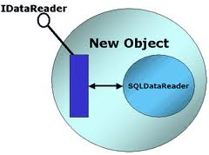

Core objects of .NET Framework data provider.
The DataReader object: Provides a read-only, forward-only stream containing your data.
  SqlDataReader
  OleDbDataReader
  OdbcDataReader
  OracleDataReader
The DataAdapter object :DataAdapter provides the communication between the Dataset and the Datasource.
  SqlDataAdapter
  OleDbDataAdapter
  OdbcDataAdapter
  OracleDataAdapter

Slide 11

Connection Object:
  This object enables you to establish and manage a connection to a database.
  To interact with a data base, you must have a connection to it.
  The connection helps to identify
    The data base server,
    The data base name
    User name
    Password
    Other parameters that are required for connecting to the data base.
  Two of the most common Connection objects used are OleDbConnection and SqlConnection.

Slide 12

Connection Object:
How to create and open connections to SQL Server.
  Before working with a database, you have to add .NET Data Provider namespace, by placing the following at the start of your code module:
    Using System.Data;
    Using System.Data.SqlClient;
  To begin "communications" with our server we should define the SqlConnection class, initialize a new instance and set its connection string parameters.

Slide 13
Connection Object:
Connection String Parameter Name | Description
Data Source | Identifies the server
Initial Catalog | Database name.
Integrated Security | Set to TRUE to make connection with user's Windows login
User ID | Name of user configured in SQL Server.
Password | Password matching SQL Server User ID.

Slide 14
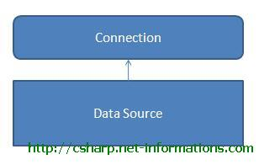
Connection object methods
Open - Opens the connection to our database.
Close - Closes the database connection.
Dispose - Releases the resources on the connection object. Used to force garbage collecting, ensuring no resources are being held after our connection is used.
State - Tells you what type of connection state (open or close)

Slide 15

Example

Slide 16


Command Object
The Command Object in ADO.NET executes SQL statements and Stored Procedures against the data source .
The Command object can execute
  SELECT statements
  INSERT
  UPDATE
  DELETE statements
  stored procedures
  Any other statement understood by the database.

Slide 17
Command Object
The Command Object required an instance of a Connection Object for executing the SQL statements.
That is you have to create a Connection Object
Open a connection
Assign the open connection to the connection property of the Command Object.
Two provider-specific classes
  SqlCommand
  OleDbCommand

Slide 18
Command Object properties
Command object has the following important properties:
  Connection :used to specify the connection to be used by the command object.
  CommandText :Used to specify the SQL statement you want to execute.
  Transaction :Used to associate a transaction object to the command object so that the changes made to the database with command object can be committed or rollback.

Slide 19
Command Object properties
CommandType :Used to specify the type of SQL command you want to execute. The CommandType property takes a values like:
  CommandType.Text:Text is the default and is set when you want to execute ant SQL command with command object.
  CommandType.TableDirect: is used to return a complete table from the database
  CommandType.StoredProcedure:which is set to call a specific stored procedure in the database

Slide 20

Command Object Methods
The SqlCommand class provides four different methods to execute a command.
  ExecuteReader :
    Expects to run a query command or a stored procedure that selects records.
    It expects to have one or more result sets to return.
  ExecuteNonQuery:
    Expects to run a command, or a stored procedure,
    That affects the state of the specified table
    You normally use this method to issue an INSERT, UPDATE, DELETE, CREATE, and SET statement.

Slide 21
Command Object Methods
  ExecuteScalar
    Expects to run a query command, or more likely a stored procedure, that returns data.
    It just makes available, as a scalar value, the first column on the first row of the selected result set.

Slide 22
Create SqlCommand
Various types of commands
  Insert, Update, Delete, stored procedure, …
Various methods can use
  First
    SqlCommand cmd = new SqlCommand("(“Insert into Country(‘India’)”, con);
  Second
    string updateString = “Insert into Country(‘India’)”;
    SqlCommand cmd = new SqlCommand(updateString ,con);

Slide 23
Create SqlCommand
  Third
    string updateString = “Insert into Country(‘India’)”;
    SqlCommand cmd = new SqlCommand();
    cmd.CommandText = updateString ;
  Fourth
    If we are using Stored Procedure
    Then you must Specify Command type.
    SqlCommand cmd = new SqlCommand(“Procedure name", connection object);
    cmd.CommandType = CommandType.StoredProcedure;

Slide 24
How Execute Commands
If we are using Stored Procedure
  Then you must Specify Command type.
  SqlCommand cmd = new SqlCommand(“Procedure name", connection object);
  cmd.CommandType = CommandType.StoredProcedure;
  Send Value to procedure as parameter
  cmd.Parameter.Add(NewSqlParameter("@A_ID”,txtname.tex);
  cmd.ExeecuteNonQuery();
If we are using Simple Command
        SqlCommand cmd = new SqlCommand("(“Insert into Country(‘India’)”, con);
    Cmd.ExecuteNonQuery()

Slide 25
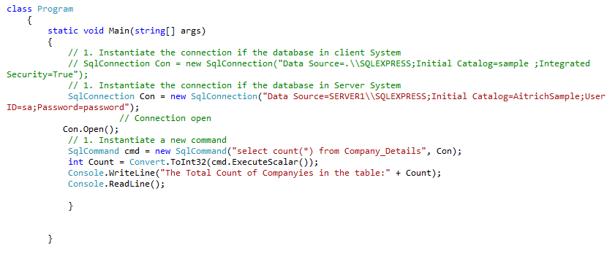
ExecuteScalar
Returns the 1st row of the 1st column in the result.
Used for commands such as: count, avg, min, max, sum

Slide 26
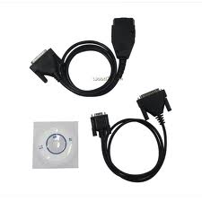
DataReader Object
Data Reader Object in ADO.NET is a stream-based , forward-only, read-only retrieval of query results from the Data Sources.
Results are returned as the query executes, and are stored in the network buffer on the client until you request them using the Read method of the Data Reader.
Retrieving data using a Data Reader involves creating an instance of the Command object
Then creating a Data Reader by calling Command.ExecuteReader to retrieve rows from a data source.
Notes:
The DataReader can increase application performance by providing faster and more efficient data access.
The DataReader is a good choice when retrieving large amounts of data because the data is not cached in memory.

Slide 27
DataReader Object
Each .NET Framework data provider included with the .NET Framework has a DataReader object:
  The .NET Framework Data Provider for OLE DB includes an OleDbDataReaderobject
  The .NET Framework Data Provider for SQL Server includes a SqlDataReader object,
  The .NET Framework Data Provider for ODBC includes an OdbcDataReader object,
  The.NET Framework Data Provider for Oracle includes an OracleDataReader object.

Slide 28
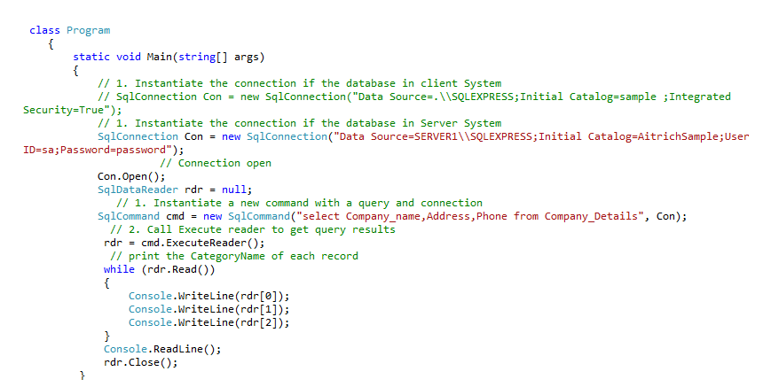
Example

Slide 29

The DataSet Object:
The DataSet object is central to supporting disconnected, distributed data scenarios with ADO.NET.
The DataSet represents a complete set of data, including related tables, constraints, and relationships among the tables.
DataSet is a mirror image of the table.
Datasets are containers — caches — in which you can store data to use in your application.
Datasets are a fundamental part of the ADO.NET architecture, providing both high-performance data access as well as scalability.

Slide 30

Data Adapter Object
DataAdapter is a part of the ADO.NET Data Provider.
The DataAdapter is the class at the core of ADO .NET's disconnected data access.
Data adapters are an integral part of ADO.NET managed providers, which are the set of objects used to communicate between a data source and a dataset.
The SqlDataAdapter, serves as a bridge between a DataSet and SQL Server for retrieving and saving data.
Data adapters available for use with databases:
  OleDbDataAdapter
  SqlDataAdapter
  OdbcDataAdapter
  OracleDataAdapter

Slide 31
When to Use a Data Adapter
Use a data adapter when you need to perform one of the following:
  Retrieve data from a data source into a data table within a data set:
    Retrieve rows from the data source using the Fill method.
      SqlDataAdapter adapter = new SqlDataAdapter();
      adapter.SelectCommand = new SqlCommand( queryString, connection); adapter.Fill(dataset);

Slide 32
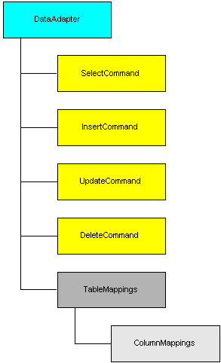

Properties of the DataAdapter

Slide 33
Properties of the DataAdapter
The first four properties are CommandObjects:
  SelectCommand – reference to a command (SQL statement or stored procedure name) that retrieves rows from the data store.
  InsertCommand – reference to a command for inserting rows into the data store.
  UpdateCommand – reference to a command for modifying rows in the data store.
  DeleteCommand – reference to a command for deleting rows from the data store.

Slide 34
Properties of the DataAdapter
Table Mappings
  The TableMappings property of data adapters.
  How tables in the result set map to the objects in the DataSet.
  The mapping links the names of columns in the source with those in the dataset table. For example, information from a column called au_id in the data source might belong in a column called author_id_number in the dataset table.
  The mapping mechanism begins to work once the SELECT command is terminated and the data adapter has returned one or more result sets.

Slide 35

The Mapping Mechanism
The Fill method maps the first result set to a DataTable object in the given DataSet.
It loops through the result set and adds rows of data to the DataTable.
When the end of the result set is reached, the method looks for a new result set and repeats the operation.
Mapping a result set to a DataSet is a process that comprises two phases:
  Table mapping
  Column mapping

Slide 36
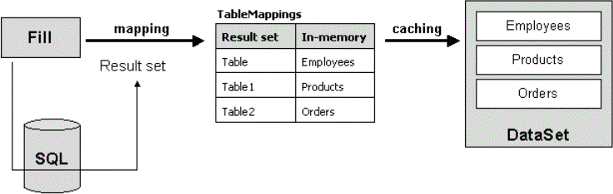
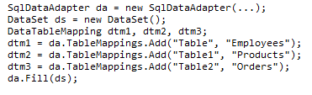

The Mapping Mechanism
Table mapping
Notes:
In Figure 1, I assume that the query produces at least three result sets. The TableMappings collection contains three default names and the corresponding mapping names. If theSELECT command creates a result set with a default name of Table, then its contents go into a new or existing DataTable object called Employees. How do you control this from a code standpoint? Look at the code snippet below:

Slide 37
DATA TABLE
  DataTable objects are used to represent the tables in a DataSet.
  A DataTable represents one table of in-memory relational data.
  The DataTable class is a member of the System.Data namespace within the .NET Framework class library.
  Create a DataTable object by using the appropriate DataTable constructor.
  The table will be given an incremental default name of TableN, starting with "Table" for Table0

Slide 38

Insert a record into Data Table
using System;
using System.Data;
class Program
{
static void Main()
{
// // Here we create a DataTable with four columns.
DataTable table = new DataTable();
table.Columns.Add("Dosage", typeof(int));
table.Columns.Add("Drug", typeof(string));
table.Columns.Add("Patient", typeof(string));
table.Columns.Add("Date", typeof(DateTime));
//Here we add five DataRows.
table.Rows.Add(25, "Indocin", "David", DateTime.Now);
table.Rows.Add(50, "Enebrel", "Sam", DateTime.Now);
table.Rows.Add(10, "Hydralazine", "Christoff", DateTime.Now);
table.Rows.Add(21, "Combivent", "Janet", DateTime.Now);
table.Rows.Add(100, "Dilantin", "Melanie", DateTime.Now);
return table;
}
}

Slide 39


Summary
ADO.NET provides functionality to developers writing managed code similar to the functionality provided to native COM developers by ADO.
ADO.NET is the .NET technology for interacting with data sources.
You have several Data Providers, which allow communication with different data sources,
The SqlConnection object lets you manage a connection to a data source.
SqlCommand objects allow you to talk to a data source and send commands to it. To have fast forward-only read access to data, use the
SqlDataReader. If you want to work with disconnected data, use a
DataSet and implement reading and writing to/from the data source with a SqlDataAdapter.

Slide 40

Reference
http://msdn.microsoft.com/en-us/library/t31h6yhs.aspx
http://msdn.microsoft.com/en-us/library/ms810286.aspx
http://vb.net-informations.com/ado.net-dataproviders/ado.net-dataadapter.htm
http://msdn.microsoft.com/en-us/library/h43ks021(v=vs.71).aspx

Slide 41
THANK YOU

